Slide 1
ReMark!
GIT Repository Link : https://github.com/prateekstark/ReMark
Prateek Garg - 2017CS10360
Rushil Gupta - 2017CS10487

Slide 2
Contents
Social Issue targeted through Game
Brief Description of the Game
Semantics of the Game
How do we plan to implement
Inspirations for the Game

Slide 3



Modern Society
This is John. He is a Software Engineer at TCS, Bengaluru. He has at least 10 hours of work daily which entirely exhausts him. He is not able to interact with his friends properly. He is constrained both in his thoughts and life.

Slide 4


Once when going through the e-Newspaper, John read about the news on Polygamy. He searched for it over the net and received following text
Polygamy and Polyandry are not lawful for Hindus (including Sikhs, Buddhists and Jains) pursuant to the provisions of Hindu Marriage Act.
Under Sunni and Shia Islamic marital jurisprudence, Muslim men are allowed to practice polygamy, that is, they can have more than one wife, but not more than four at the same time.

Slide 5
Why stereotypes exist?
Busy work schedule restrict people from being social.
Learning becoming more and more one way.
Substantial influence of ideals in the Indian society.
People aren’t aware of situations other people face, leading to the more prevalent extremist thoughts.
One solution
Promoting discussions leading to moderation of the extremist thoughts present.

Slide 6


ReMark
An engaging and euphoric party game built with an aim of expanding your social communication.
Multiplayer 18+

Slide 7








ReMark

Slide 8
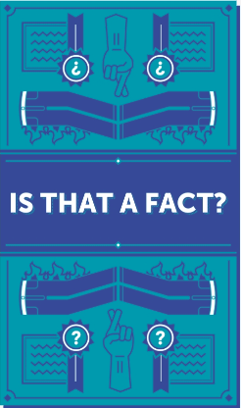



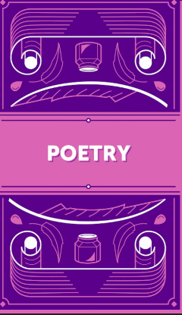
THEMES

Slide 9
How to Play?
The game presents you with multiple choices of the genres you can play in.
Every genre contains an option to select the number of rounds you want to continue the game for. The maximum limit for the number of rounds is 15 and minimum is 5.
The player is then assigned a secret code with which he connects other players to the room.
Once the game begins, at every round a word is popped on the screen.
A clock timer of 30 seconds starts, during which the player has to write a remark, whatever comes first to his mind on seeing the word.
After 30 seconds all responses appear on every player’s screen wherein they like the best response. (Player can choose their own parameters for judgement)
The person with maximum number of likes is awarded the points for the round and the game continues.

Slide 10

Implementation Strategy
We plan to implement our game to function on our Android Mobile Phones i.e. we wish to build a mobile game with the help of Android Studio.
We believe we will be able to complete the first draft of our App with basic UI and play by the end of April.
The rectification of the App in correspondence with the feedback received from our trial users shall be our prime agenda in the hackathon on 5th and 6th of May.

Slide 11
Inspiration
The main inspiration of this app is the lack of communication among people these days due to the hectic life schedule.
We can see instances of people getting involved in issues, they do not have complete knowledge for.
The main reason behind these extremist views is that we do not see the point of view of other people. We do not have a different perspective to the issue because we are blocked.
ReMark aims at improving your social communication by giving you a chance to connect with random strangers giving you an insight of viewpoints other than yours thus helping you shape your notions on various pertinent issues
P.S. - You can also test your humour though! :D

